Slide 1

A Natural Language Processing Project on Real or Fake News Detection
Team Members:
Pavan Raju
Sanjeev Raj
Pavan Gowda
Shivangi Thakur
Shubham Samal
Anand Venkata
Abhishek Warfade
Mentor:
Neha Gupta

Slide 2
Contents
1. Introduction
2. E DA & Pre-processing
3. Modelling and Evaluation

Slide 3
1. Introduction
2. EDA and pre-processing
3. Model building and Evaluation

Slide 4

Abstract
Daily events have typically been reported by mass media sources, particularly the news portals and social media.
The dependability of information on the internet has become a critical issue in modern life in recent years.
Fake news on social media and the internet is influencing people to the point that it needs to be stopped.
Our goal is to develop a reliable model that classifies a given information is either fake or true.

Slide 5

Introduction
According to the fact-checking website, Politifact,
"Fake news is made-up stuff, masterfully manipulated to look like credible journalistic reports that are easily spread online to large audiences willing to believe the fictions and spread the word.“
Now more than ever, it's vital to differentiate between real and fake news. Let's explore the key characteristics and methods to detect misleading information.

Slide 6

Types of News Sources
1
Mainstream News Outlets 📺
2
Social Media Platforms 📱
3
Satire and Parody Sites 😂
Established media organizations with a reputation for fact-checking and journalistic ethics.
User-generated platforms where news can spread rapidly but often without proper verification.
Websites that intentionally publish humorous or exaggerated news articles.

Slide 7

Common Characteristics of Real News
1
Multiple Reputable Sources ✔️
2
Unbiased Reporting 📰
3
Fact-Checked Content ✔️
Real news articles typically cite multiple credible sources and provide references for factual claims.
Objectivity and balanced coverage are key attributes of real news articles.
Real news undergoes rigorous fact-checking processes to ensure accuracy.

Slide 8
Common Characteristics of Fake News
Emotional Language 😡
Poor Writing and Grammar 📝
Lack of Credible Sources ❌
Fake news articles often use sensationalized language to evoke an emotional response.
Errors in spelling, punctuation, and grammar can indicate unreliable sources.
Fake news rarely provides verifiable sources or references.

Slide 9
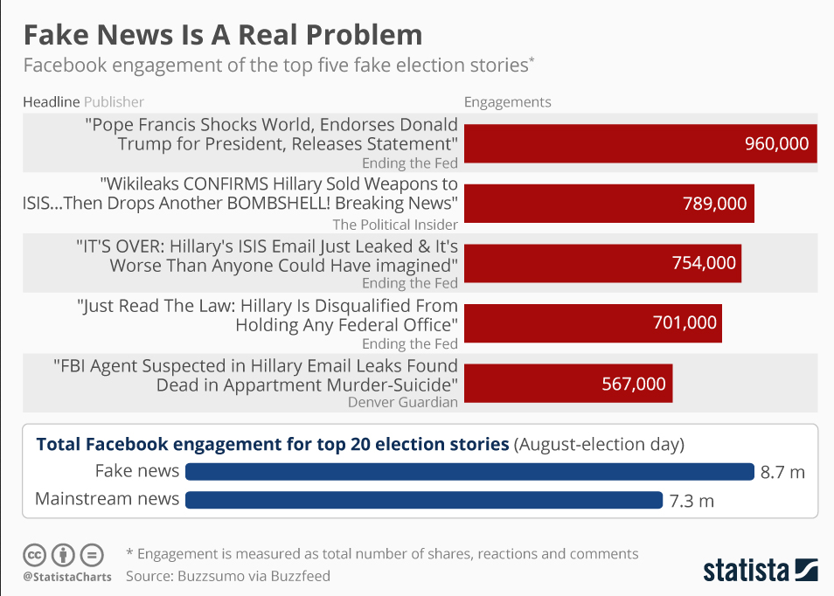

Slide 10

Project Overview
Objective
Data Sources
Develop a robust NLP model to identify and analyze fake news articles.
Collect a diverse dataset of news articles from various sources.
NLP Techniques
Algorithms
Apply advanced techniques like sentiment analysis and topic modeling.

Slide 11
Project Workflow:
Understanding the objectives
Importing the necessary libraries
Loading the Dataset
Data Understanding
Data preprocessing
Exploratory Data Analysis (EDA)
Feature Scaling
Data Visualization
Model Building
Model Training and Testing
Model Deployment

Slide 12

Fake News Detection and Analysis
Fake news refers to fabricated or misleading information presented as factual news. NLP techniques can be used to identify patterns and linguistic cues that distinguish fake news from real news. Analyzing fake news helps in understanding the spread and impact of misinformation.

Slide 13
Data Collection and Pre-processing
Data Sources
Data Cleaning
Text Pre-processing
Collect a wide range of news articles from social media, news websites, and online platforms.
Remove irrelevant content, correct spelling errors, and standardize the format of the collected articles.
Tokenize, lemmatize, and remove stop words to prepare the text data for further analysis.

Slide 14

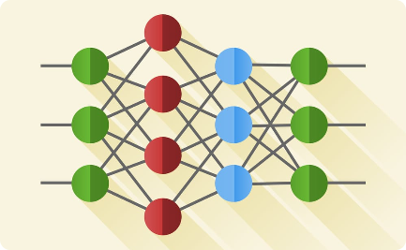
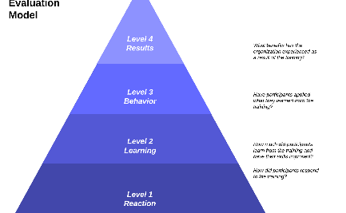
Model Selection and Training
Supervised Learning
Deep Learning
Model Evaluation
Train a classification model using labeled data to distinguish between fake and real news.
Explore the use of deep neural networks for more accurate fake news detection.
Assess the performance of the trained models using evaluation metrics like accuracy, precision, and recall.

Slide 16

Evaluation and Results
1
Training and Testing
Split the dataset into training and testing sets to evaluate model performance.
2
Performance Metrics
Measure the accuracy, precision, recall, and F1-score of the developed models.
3
Comparison
Compare the performance of different models and identify the most effective approach to fake news detection.

Slide 17
Conclusion and Future Work
Our project showcased the power of NLP in tackling the challenging task of fake news detection and analysis. Moving forward, we aim to refine our models, expand the dataset, and explore real-time fake news detection.

Slide 18

Introduction to Natural Language Processing
Natural Language Processing (NLP) is a branch of artificial intelligence that focuses on the interaction between computers and human language. It involves extracting meaning from text and enables machines to understand and interpret human language.

